Slide 1
NEWCASTLE CORE ZONING CODE
Article 3 · Thoroughfares
PROPOSED AMENDMENT TO THE CORE ZONING CODE
ARTICLE
THOROUGHFARES
3
What the article would do — a factual overview
Special Town Meeting · Monday, September 14, 2026

Slide 2
NEWCASTLE CORE ZONING CODE
Article 3 · Thoroughfares
WHAT THE ARTICLE WOULD DO
1
Adds Article 3, Thoroughfares
Standards for streets, roads, driveways and entrances
2
Repeals the Road, Driveway, and Entrance Ordinance
Adopted November 3, 2020 · in effect since January 1, 2021
3
Renumbers the Articles that follow
Site Standards through Definitions become Articles 4–9
4
Makes related changes in Articles 2, 4, 8 and 9
Including new definitions for the terms Article 3 uses
Full text: Core Zoning Code, Town Meeting Edition v1.0
2
|
Newcastle Core Zoning Code
Special Town Meeting · September 14, 2026

Slide 3


NEWCASTLE CORE ZONING CODE
Article 3 · Thoroughfares
HOW ROADS ARE SORTED
TODAY · 2020 ORDINANCE
PROPOSED · ARTICLE 3
By ownership — three standards
By setting — ten Types
RIGHT-OF-WAY
TRAVEL WAY
SURFACE
Public Road
50 ft
20 ft
Paved
Private Road
50 ft
12 ft
Not required
S1 Main Street
50–62 ft right-of-way
Driveway
No design standards — entrance rules only
Under Article 3, ownership is recorded separately: Town Way, Public Easement, Private Road, or State Highway.
R3 Rural Lane
33–50 ft right-of-way
S1
S2
S3
S4
S5
R1
R2
R3
R4
R5
3
|
Newcastle Core Zoning Code
Special Town Meeting · September 14, 2026

Slide 4
NEWCASTLE CORE ZONING CODE
Article 3 · Thoroughfares
WHAT CARRIES OVER — AND WHAT’S NEW
CARRIES OVER FROM THE 2020 ORDINANCE
NEW IN ARTICLE 3
Driveway limit: two single-family homes, or one two-family home
Every road segment assigned a Type in advance
Widths set by Type, not by ownership
Entrance sight-distance table — same values
A driveway expanded to serve 3–4 homes: safety essentials only
Routine maintenance does not trigger the standards
Protection for significant street trees along Streets
Turnaround required on dead ends over 150 ft
Maximum grade by Type, 6% to 12% (was 8% public, 10% private)
New roads stay private until Town Meeting accepts them
4
|
Newcastle Core Zoning Code
Special Town Meeting · September 14, 2026

Slide 5
NEWCASTLE CORE ZONING CODE
Article 3 · Thoroughfares
EXISTING ROADS AND DRIVEWAYS
Adopting Article 3 does not require any existing road or driveway to be changed.
§1.B.5
A DRIVEWAY REMAINS A DRIVEWAY
§7.C.8
A TYPE’S STANDARDS APPLY ONLY WHEN
A way serving up to two single-family homes, or one two-family home, stays a driveway — whatever name or Type the Inventory lists for it.
A new road is built
A road is substantially reconstructed — widened, extended, given sidewalks, or paved from gravel
Ways already serving three or four homes may continue as they are. §14.C.3
A driveway is expanded to serve more homes:
3–4 homes: safety essentials
·
Routine maintenance — patching, resealing, replacing a culvert — does not trigger the standards.
5 or more, a subdivision, or a Town Way: the full Type
·
5
|
Newcastle Core Zoning Code
Special Town Meeting · September 14, 2026

Slide 6
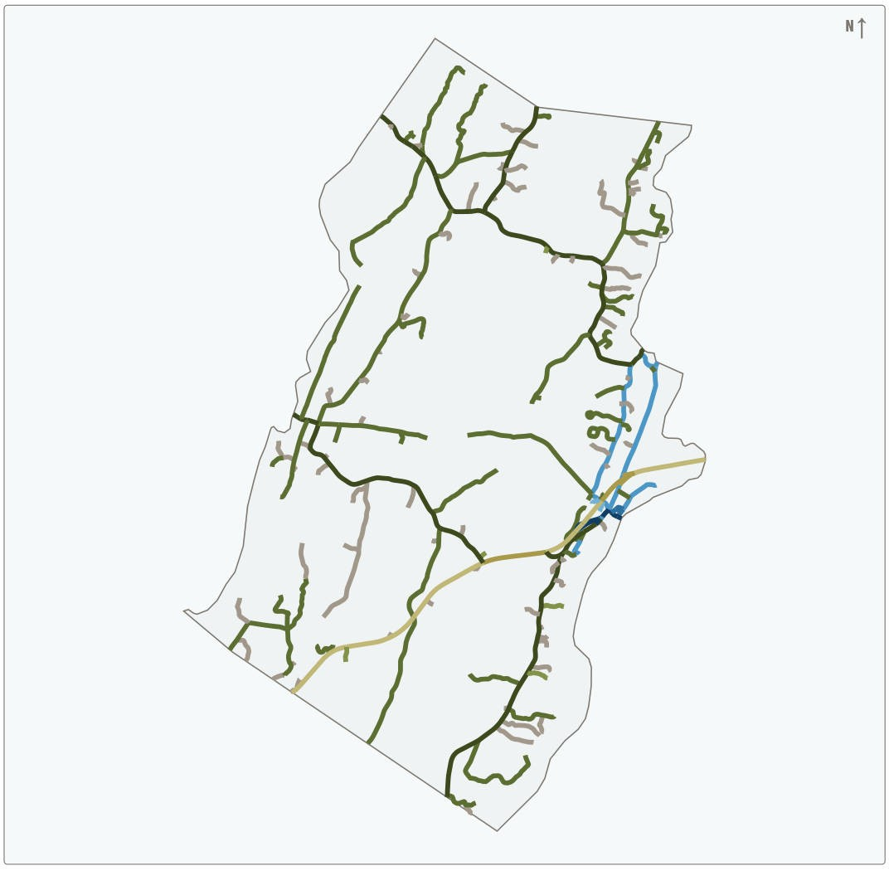
NEWCASTLE CORE ZONING CODE
Article 3 · Thoroughfares
THE INVENTORY AND MAP
EVERY ROAD, LISTED IN ADVANCE
214 road segments on 148 named roads
Each segment’s Type is set at adoption — no case-by-case ruling when it is later built or improved §5.C.6
72 are recorded as driveways today and shown as D — for reference only §7.C.8
A Type changes only by reclassification — a Planning Board hearing, then Town Meeting §5.E
S1 Main Street
R1 Connector Road
S2 Village Street
R2 Rural Road
S3 Neighborhood Street
R3 Rural Lane
Exhibit 3.2, Thoroughfare Type Map — illustrative; the Inventory (Exhibit 3.1) governs
S4 Lane
R4 Highway Commercial
D Driveway today
R5 Rural Highway
6
|
Newcastle Core Zoning Code
Special Town Meeting · September 14, 2026

Slide 7
NEWCASTLE CORE ZONING CODE
Article 3 · Thoroughfares
WHAT PUBLIC INPUT CHANGED
Residents gave input by phone, email, and in conversation before the public hearing on August 20, 2026, and at the hearing itself.
WHAT WAS RAISED
WHAT CHANGED IN THE DRAFT
BEFORE THE HEARING
Adoption requires no upgrades; any later requirement scales with the number of homes served
Short “road stubs” on the map are driveways today
BEFORE THE HEARING
Significant street trees protected when work is done in the right-of-way
Protect mature trees along streets
PUBLIC HEARING · AUGUST 20, 2026
Added “A driveway remains a driveway”; driveways now shown as D in the Inventory and Map
Would a driveway listed in the Inventory have to be built as a road?
AFTER THE HEARING · INCLUDING A RESIDENT’S FIELD RESEARCH
Driveways recorded rose from 4 to 72; Rural Lane (R3) segments from 10 to 76
Which small private ways are really driveways?
7
|
Newcastle Core Zoning Code
Special Town Meeting · September 14, 2026

